Slide 1
Fire Safety Inspection Portal

Slide 2
INTRODUCTION:-
The Fire Inspection Project will be a Web portal , Which will be used by the Client ( Fire Inspection Consultant) . This portal will help clients to Manage the record of clients for their fire extinguisher equipment inspections .

Slide 3
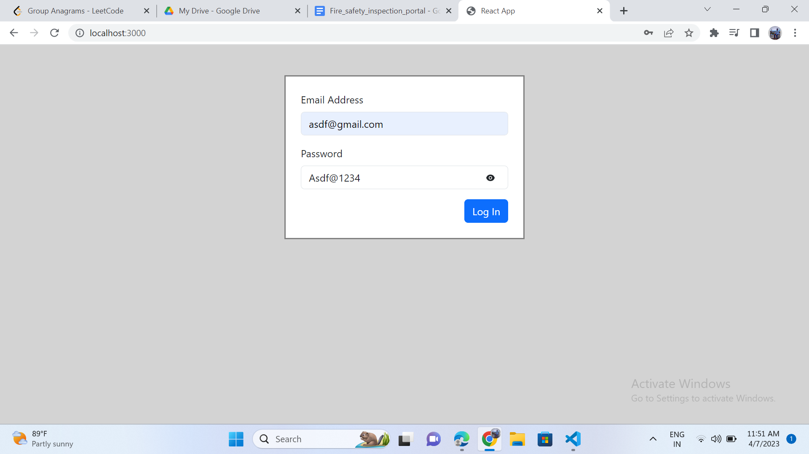
Starting interface of Application

Slide 4
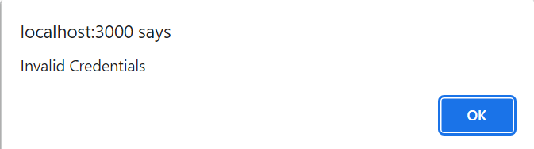
Start
Login
Check
No
Credential
Yes
Dashboard
End

Slide 5
Different Modules Of Application
Modules
Dashboard
Client
Product
Inspector
Details
Add New

Slide 6
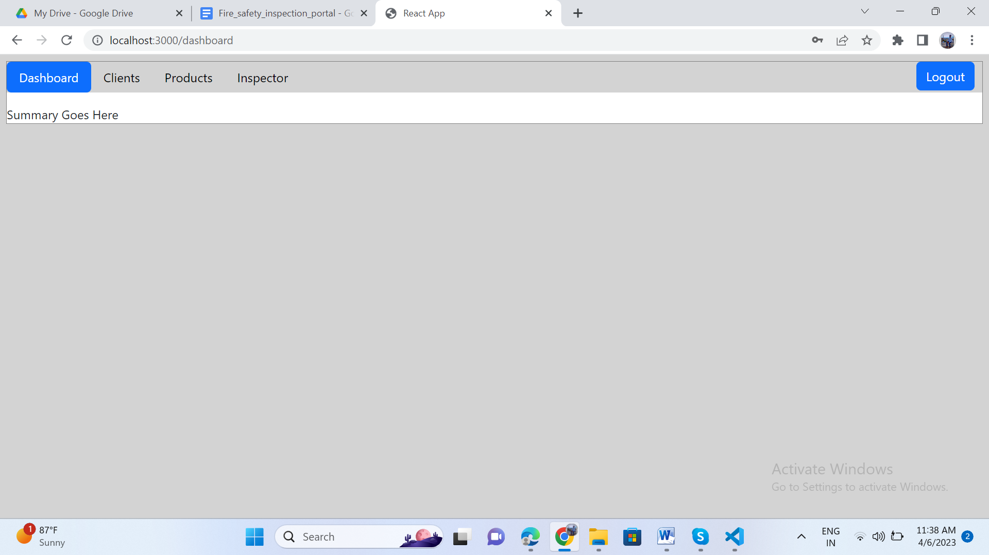
Home Page of Application

Slide 7
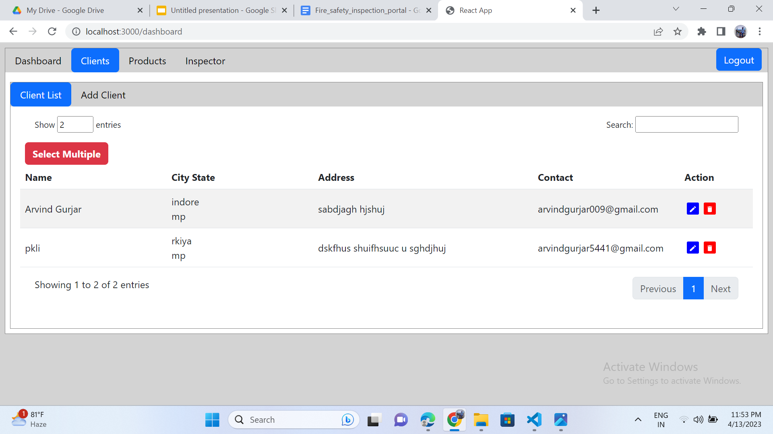
Details

Slide 8
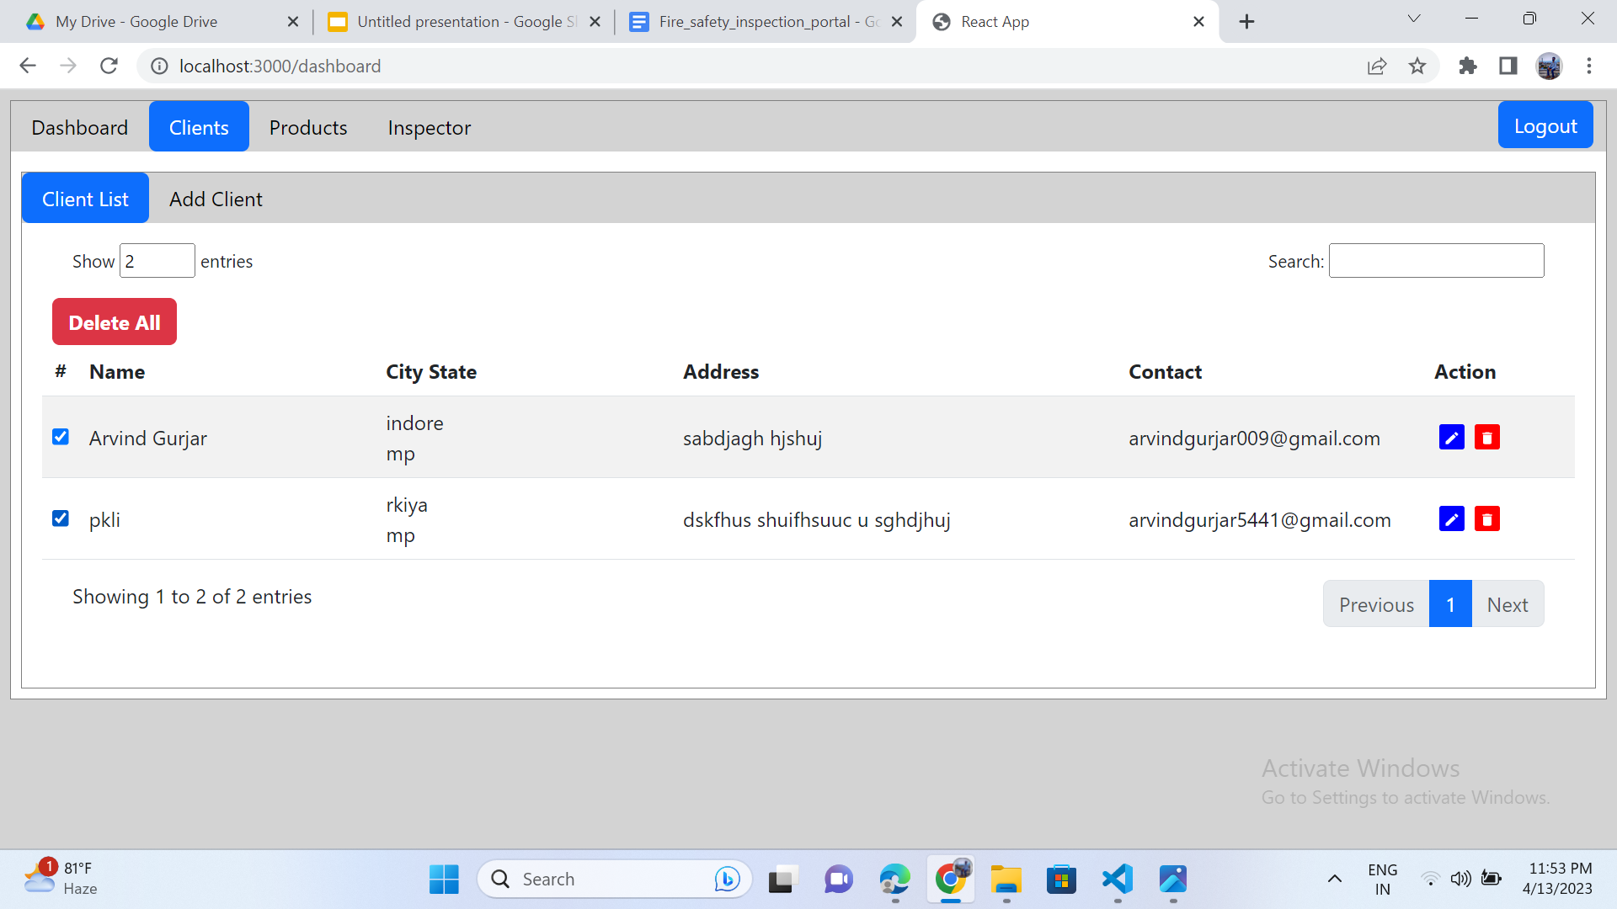
How to delete multiple

Slide 9
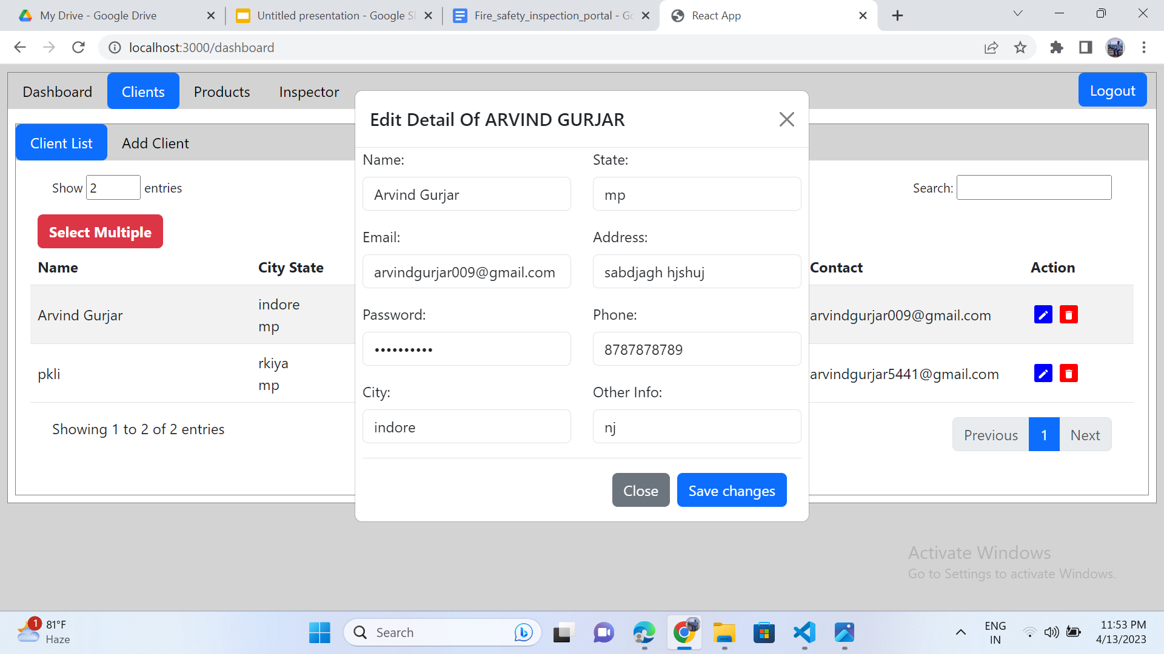
How to edit details

Slide 10
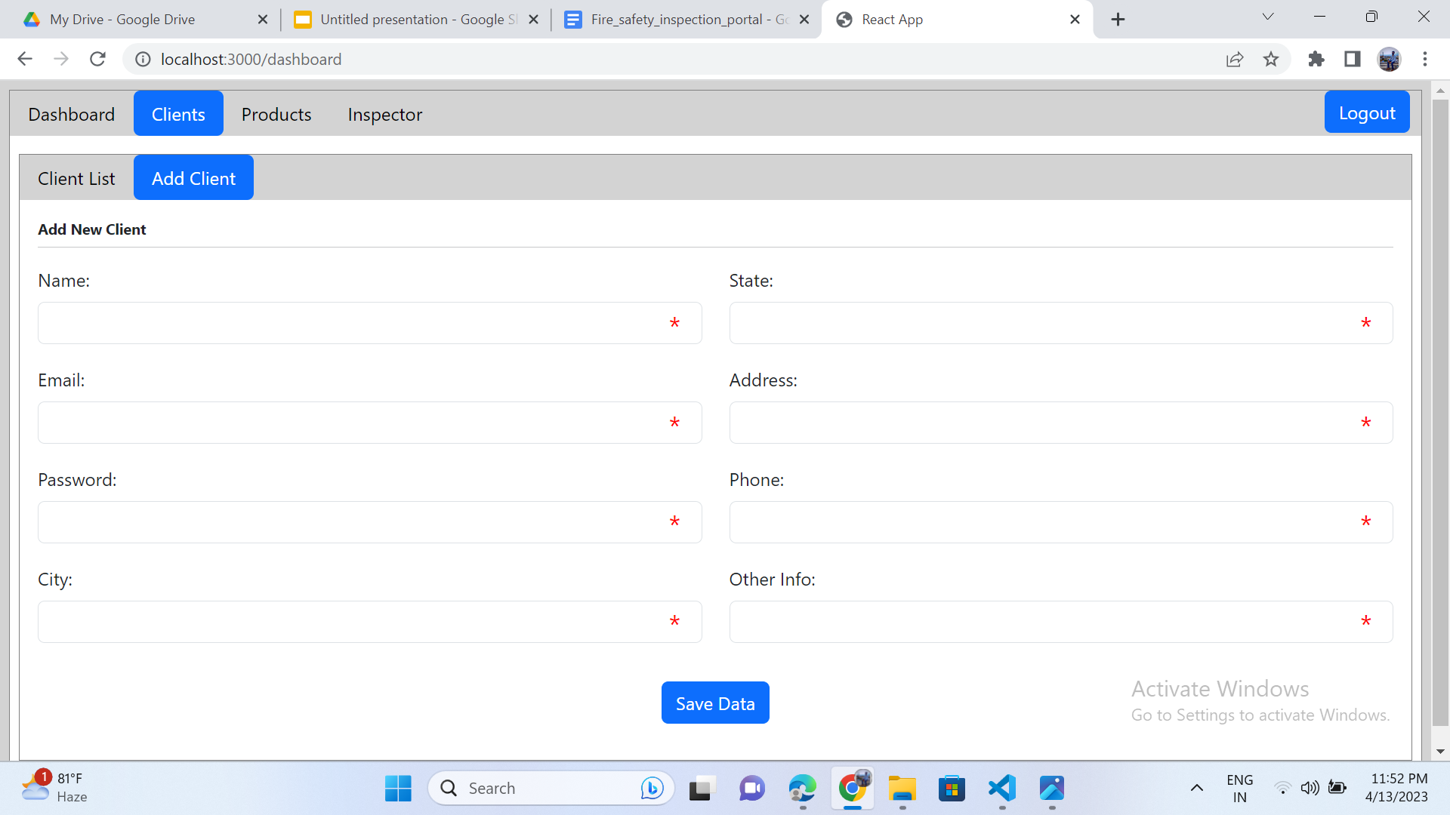
How to detect error message in form

Slide 11
Thank You

